Slide 1
Your purpose checkup

Slide 2
Why?
©2017 Inventure - The Purpose Company richardleider.com

Slide 3
What?
©2017 Inventure - The Purpose Company richardleider.com

Slide 4
Who?
©2017 Inventure - The Purpose Company richardleider.com

Slide 5
“… the last of the human freedoms – to choose one’s attitude in any given set of circumstances…”
The choice
- Viktor Frankl

Slide 6
Old story
personal growth
childhood
adolescence
adulthood
retirement
old age

Slide 7
New story
personal growth
childhood
adolescence
adulthood
new life stage
retirement
old age

Slide 8
Self renewal
personal growth
childhood
adolescence
adulthood
new life stage
retirement
old age

Slide 9
The purpose moment
©2017 Inventure - The Purpose Company richardleider.com

Slide 10
Purpose myths
©2017 Inventure - The Purpose Company richardleider.com

Slide 11
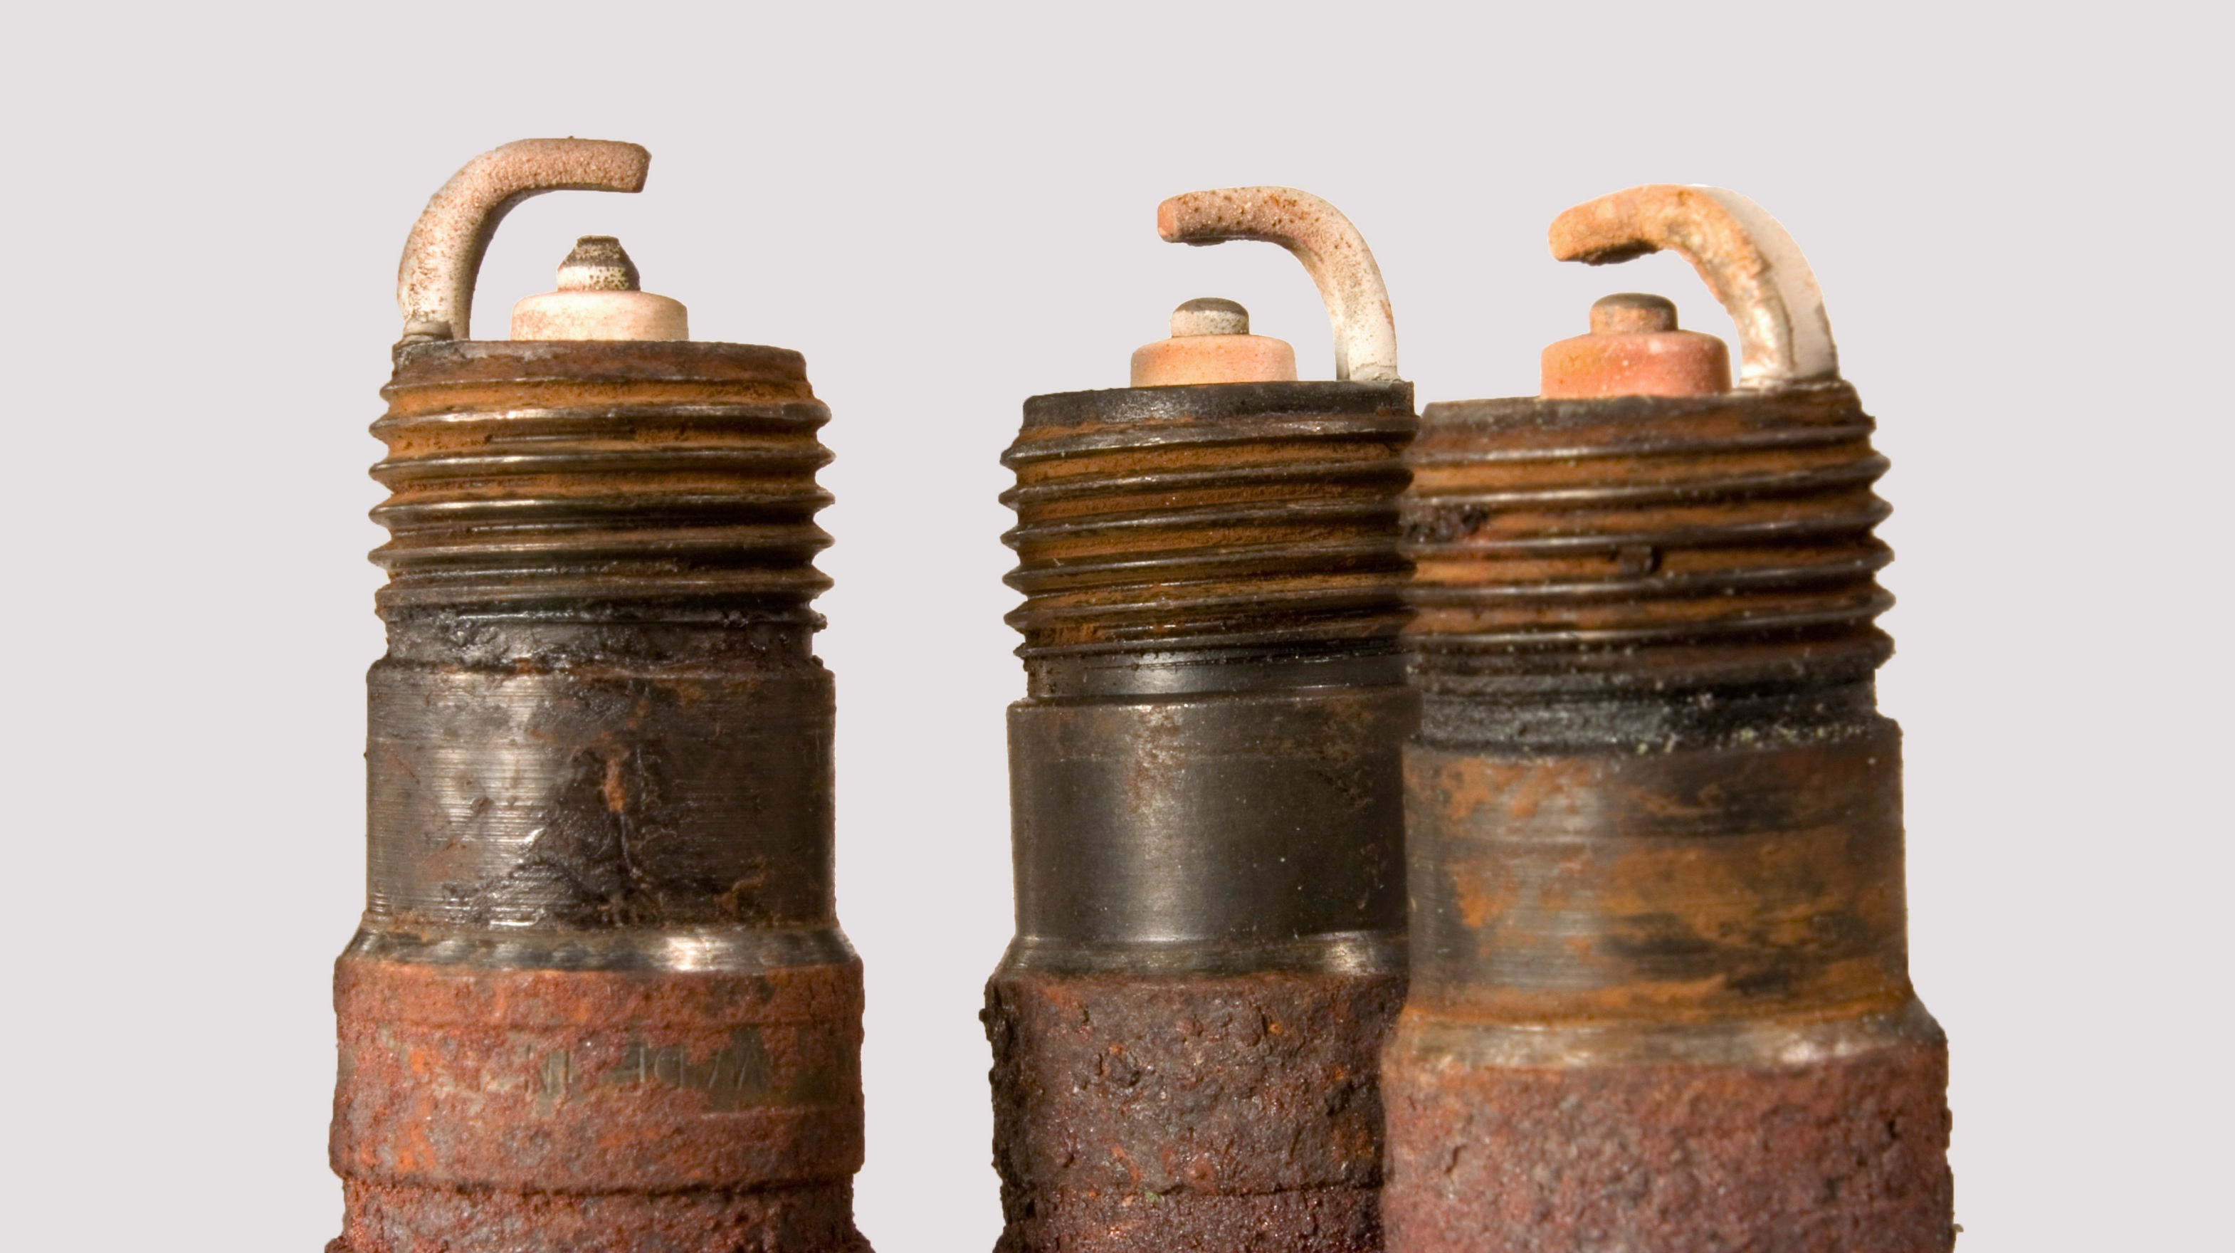
Career checkup
©2017 Inventure - The Purpose Company richardleider.com

Slide 12
What do you do?
©2017 Inventure - The Purpose Company richardleider.com

Slide 13
Why do you do what you do?
©2017 Inventure - The Purpose Company richardleider.com

Slide 14
Do you love what you do?
©2017 Inventure - The Purpose Company richardleider.com

Slide 15
The call
Meaning
Mission
Calling
Failure
Success
Job
Career
Despair

Slide 16
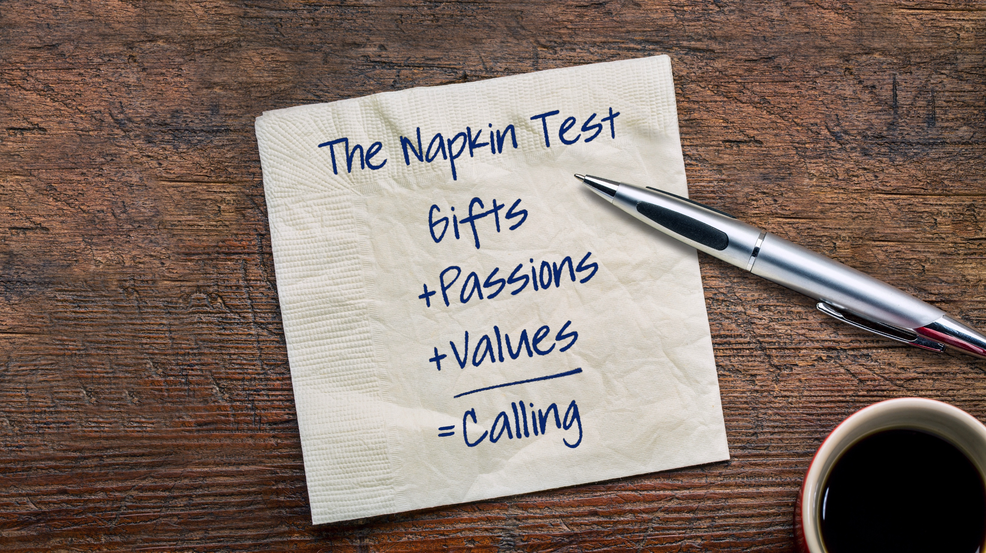
The napkin test
©2017 Inventure - The Purpose Company richardleider.com

Slide 17
The mirror test
©2017 Inventure - The Purpose Company richardleider.com

Slide 18
Center yourself
STEP 1 Pause
STEP 2
Breathe
STEP 3 Picture
©2017 Inventure - The Purpose Company richardleider.com

Slide 19
“I arise in the morning torn between a
desire to improve (or save) the world
and a desire to enjoy (or savor) the world.
This makes it hard to plan the day.”
- E. B. White

Slide 20
Unlock the power of purpose
©2017 Inventure - The Purpose Company richardleider.com

